Slide 1
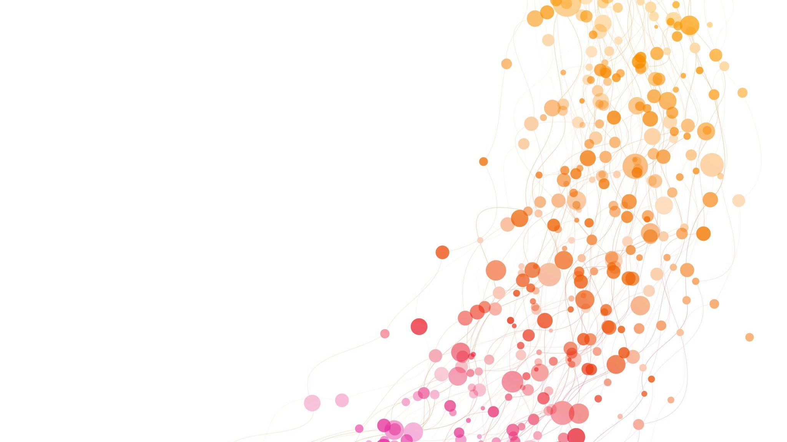
The Algorithm Showcase
By: Yachty Smith

Slide 2
Objective
Add Three New Buttons
Create and integrate three additional buttons into the existing GUI layout.
Ensure consistent styling and placement within the current design.
Integrate Three New Algorithms
Retrofit three algorithms into the existing codebase.
Ensure compatibility with the current system architecture.
Display the step-by-step process of each algorithm’s execution in the GUI for better visualization and debugging.
Button–Algorithm Mapping
Configure each new button to properly trigger and run the corresponding algorithm.
Provide clear feedback (e.g., status messages, animations, or highlights) to confirm execution.
Add a Settings Button
Implement a dedicated Settings button in the GUI.
The button should open a configurable panel or window for user customization.
Settings Panel Controls
Add controls that allow users to:
Change the starting position.
Change the ending position.
Adjust other algorithm-specific or application parameters.

Slide 3
How?

Slide 4
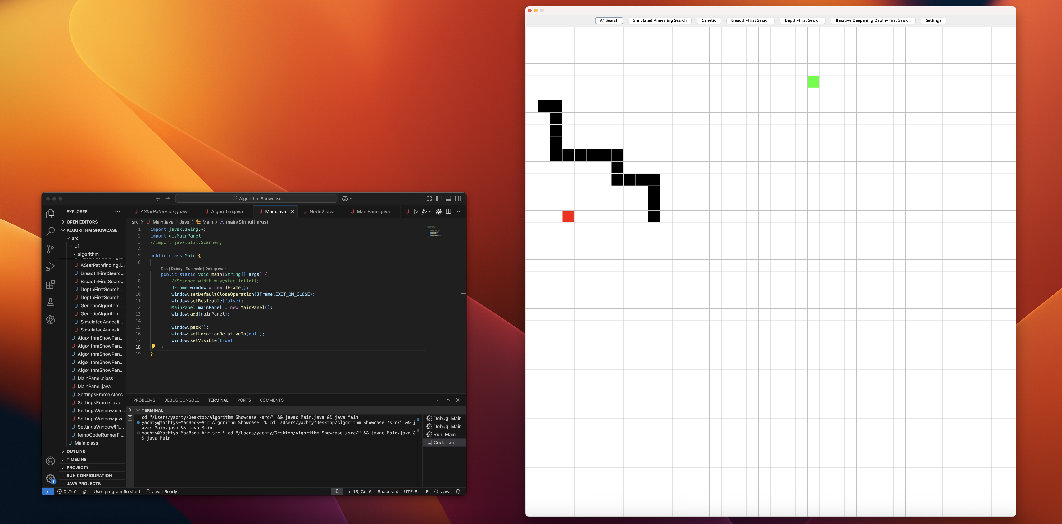
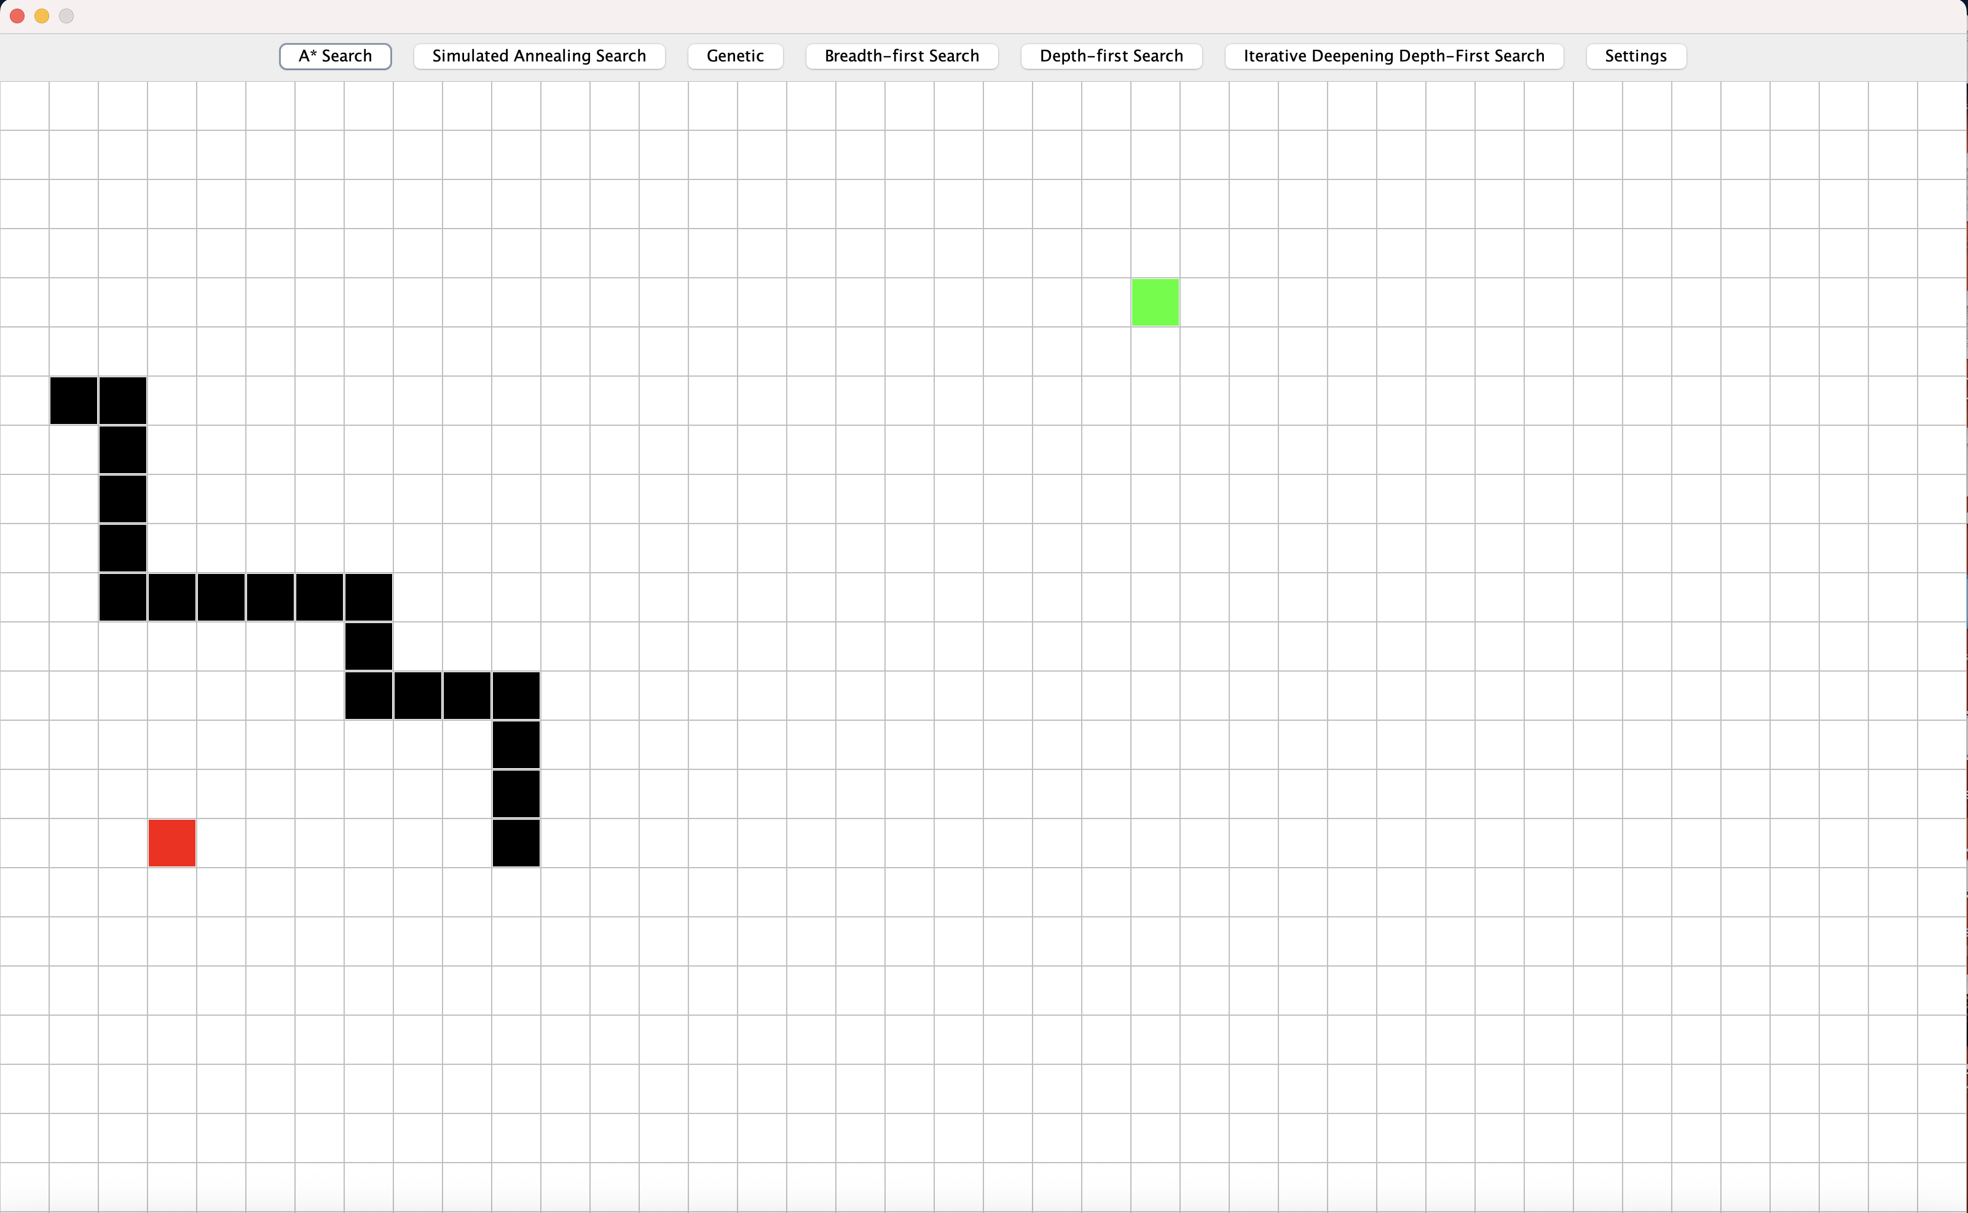

Slide 5
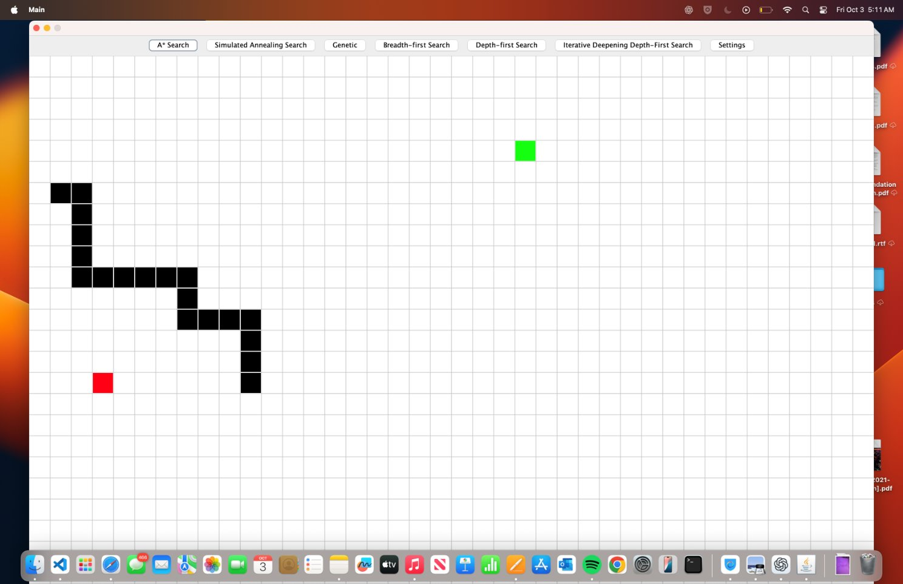
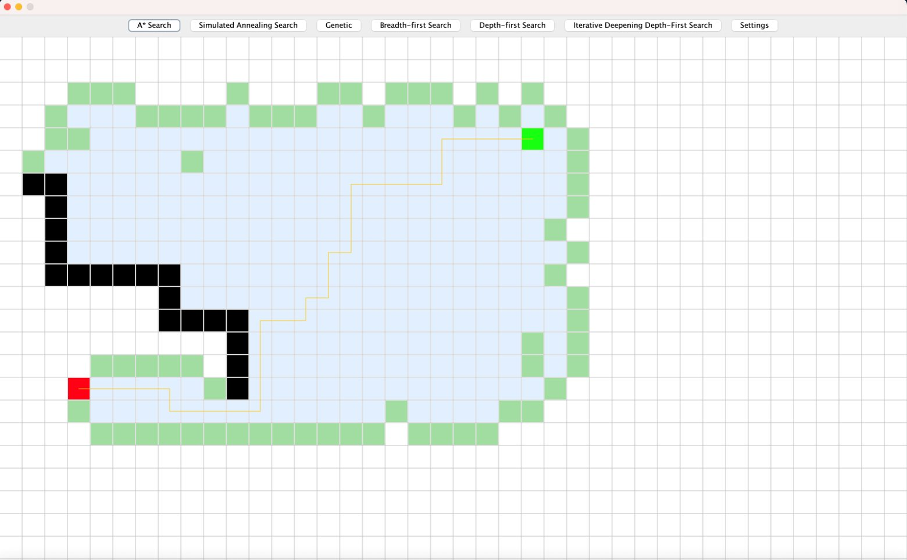

Slide 6
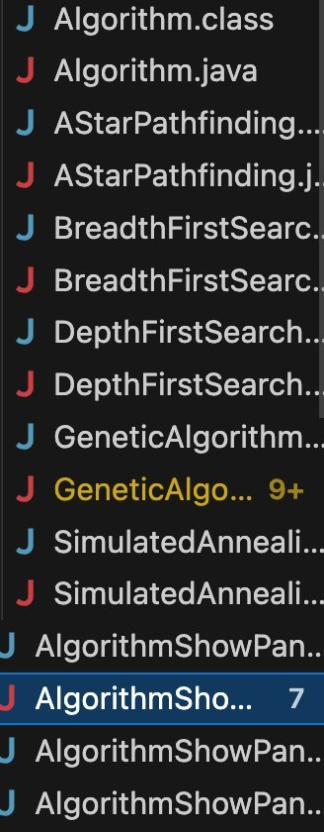
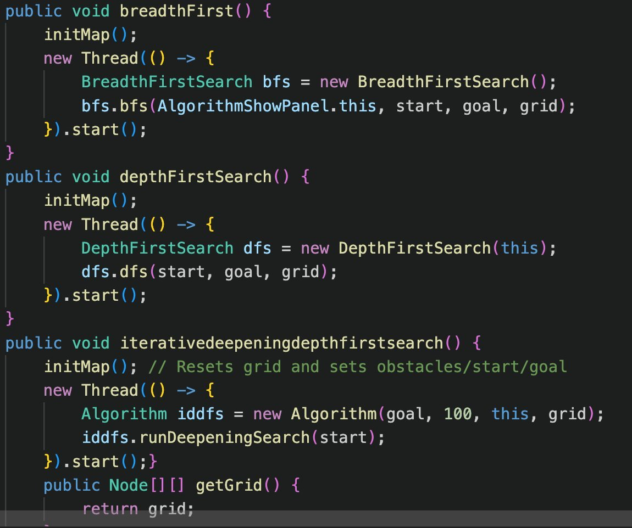
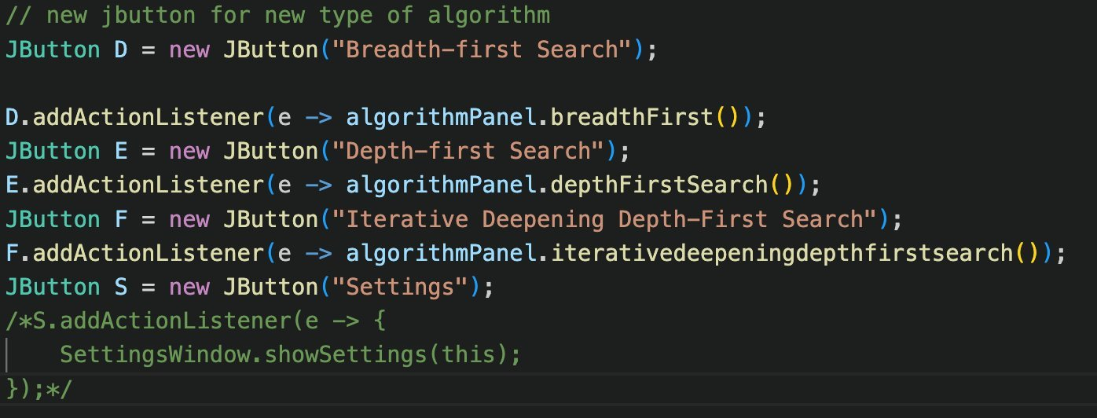

Slide 7
Conclusion
Algorithm Integration: Three new algorithms were implemented and seamlessly retrofitted into the existing codebase. Each algorithm is fully functional within the GUI and provides a clear, visualized step-by-step process of its execution.
Interactive Buttons: Three new buttons were added to the interface, each properly mapped to its corresponding algorithm. This ensures smooth execution and an intuitive user experience.
Settings Panel: A dedicated settings panel was introduced, giving users more control over the application. Within this panel, users can easily adjust the starting and ending positions as well as configure additional parameters for customization.

